Slide 1
Hospital

Slide 2
TEAM
عبدالرحمن زكريا سنوسي خالد
عبدالله محمد عبدالسيد حسين
عبدالرحمن عبدالماجد يوسف نوح
عبدالرحمن صلاح الدين سعد محمود بنداري

Slide 3
We created this project about the hospital. In this project, we created a database that includes all things. As we know, the hospital contains employees, doctors, nurses, patients and rooms. We made their tables and added the necessary information for each of them

Slide 4
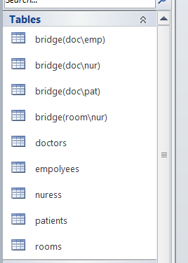

Slide 5
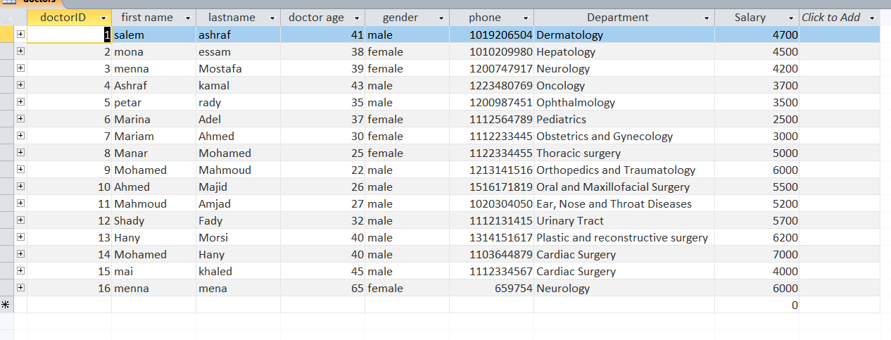
We have added the necessary data for employees, doctors, nurses, patients and room data as follows

Slide 6
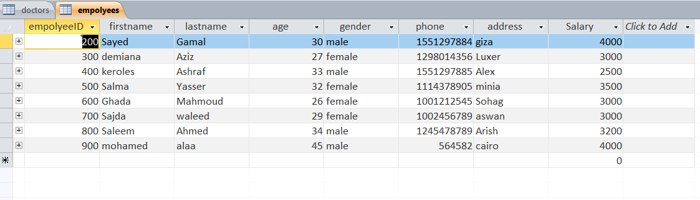

Slide 7
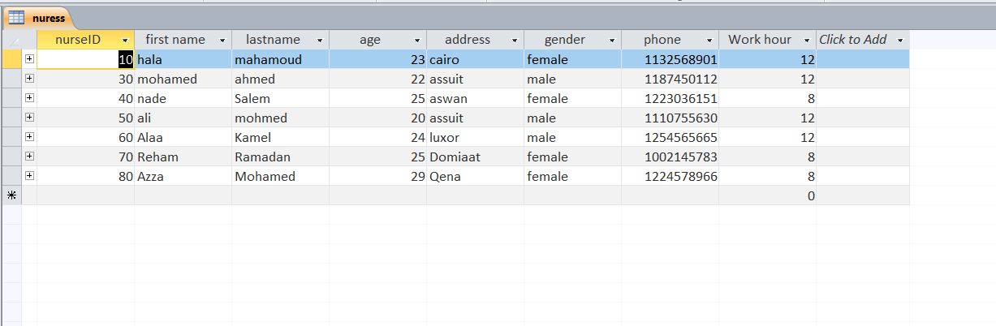
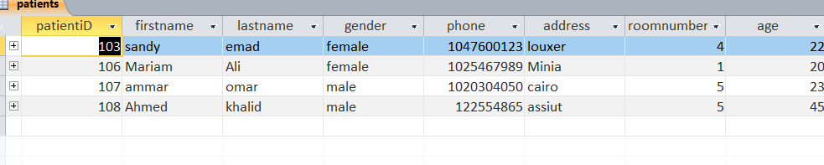

Slide 8
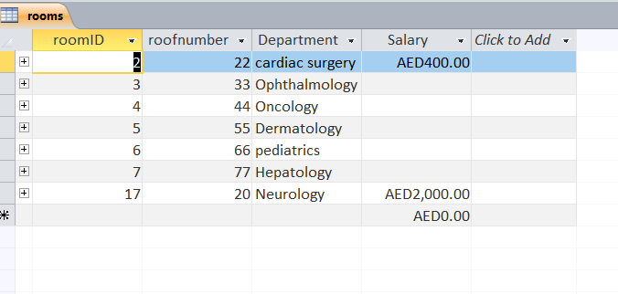

Slide 9
Relations
Then we defined the primary key for the tables and linked the tables together with relationships such as One to Many One to one ,many to many

Slide 10
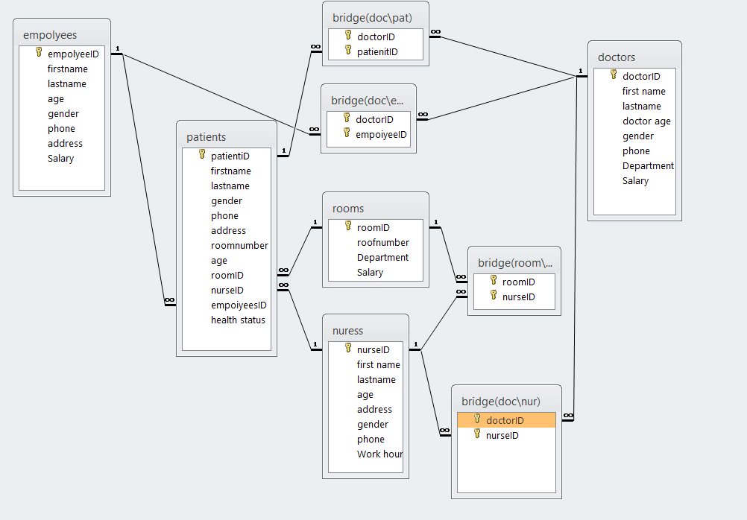

Slide 11
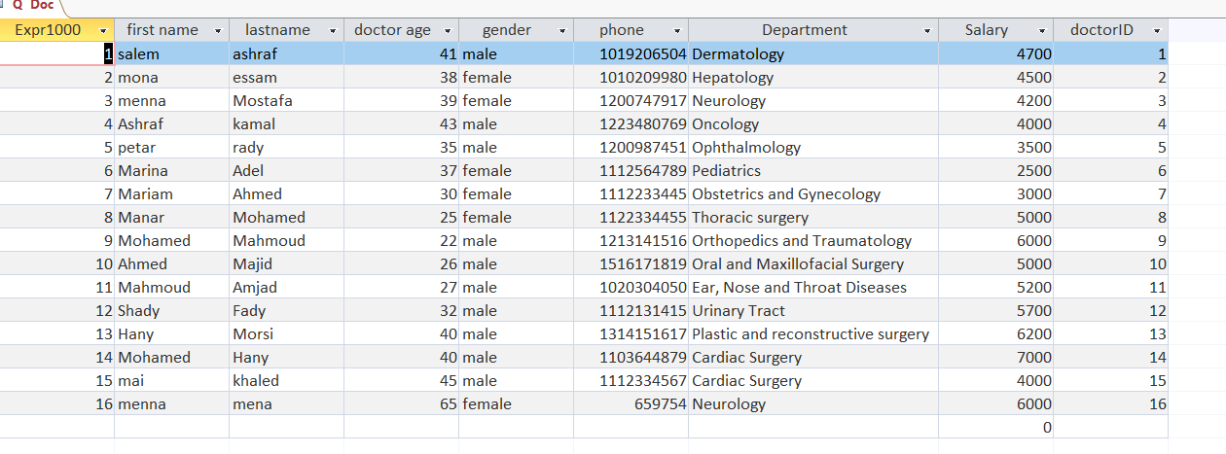
Query SEL

Slide 12
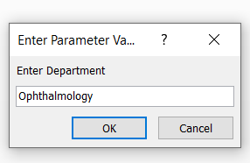
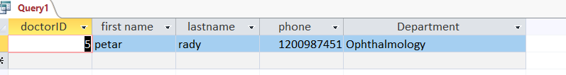

Slide 13
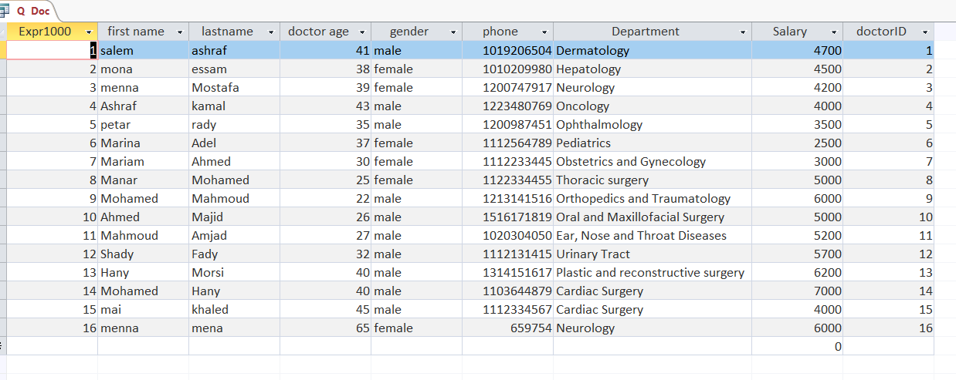

Slide 14
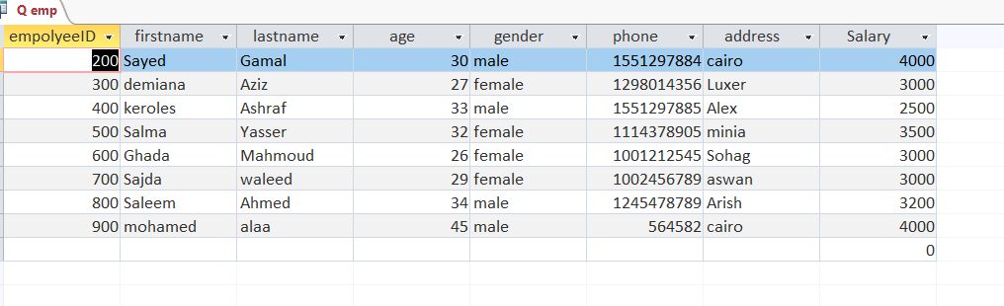

Slide 15
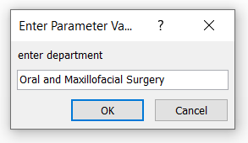
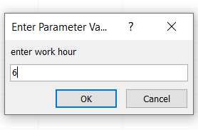
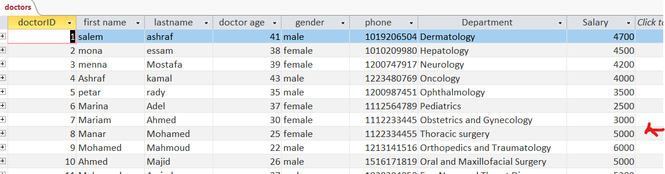
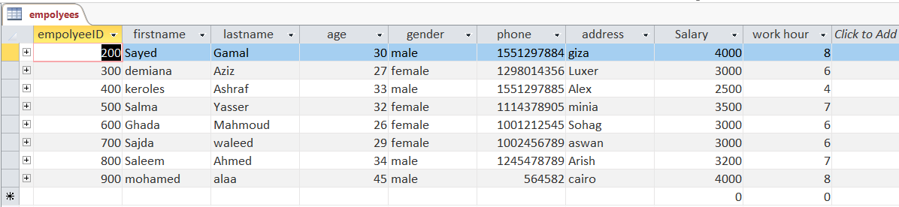
Query update

Slide 16
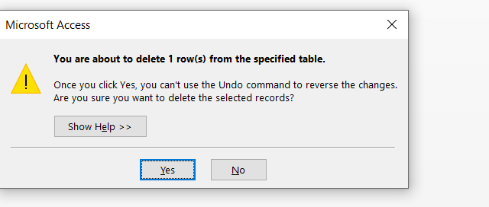
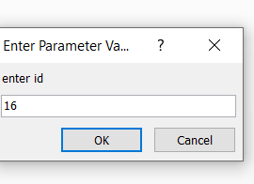
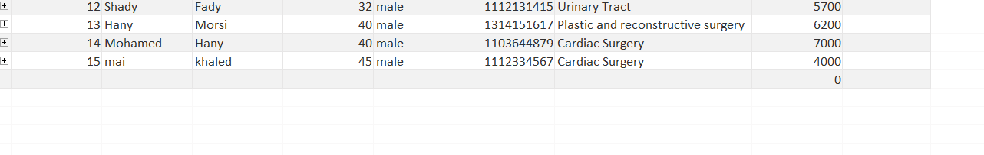
QUERY DEL

Slide 17
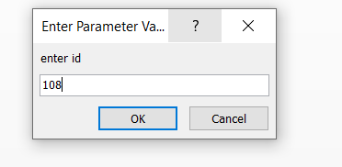
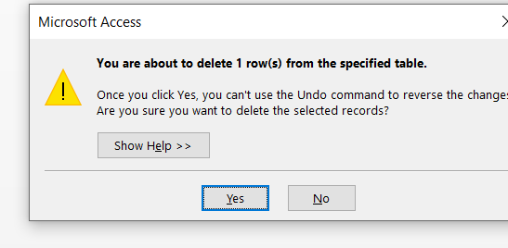
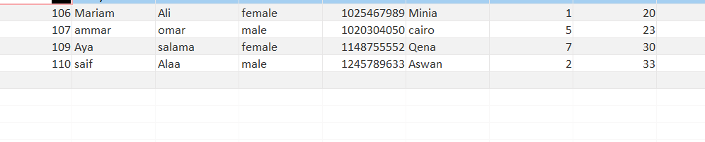
Query DEL

Slide 18
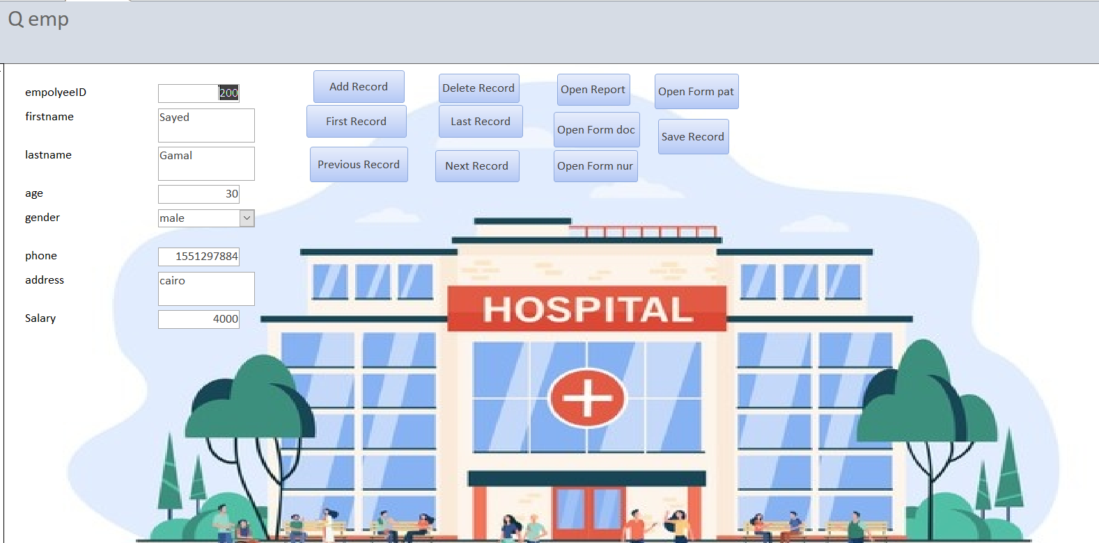
FORM

Slide 19
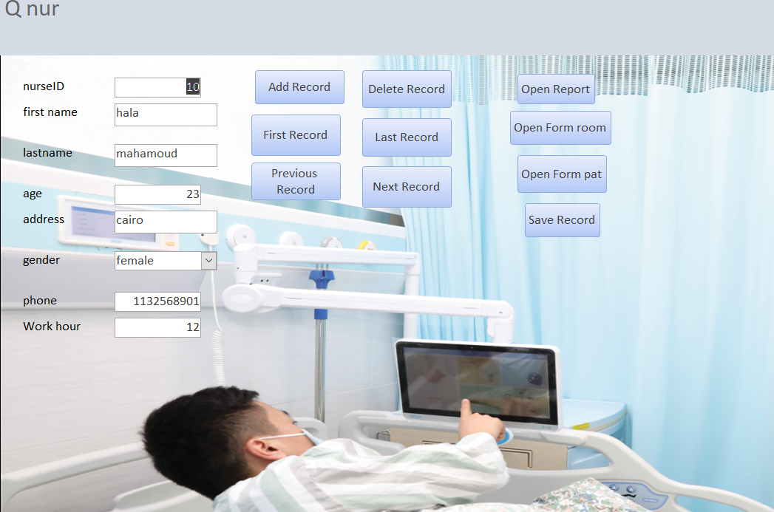

Slide 20
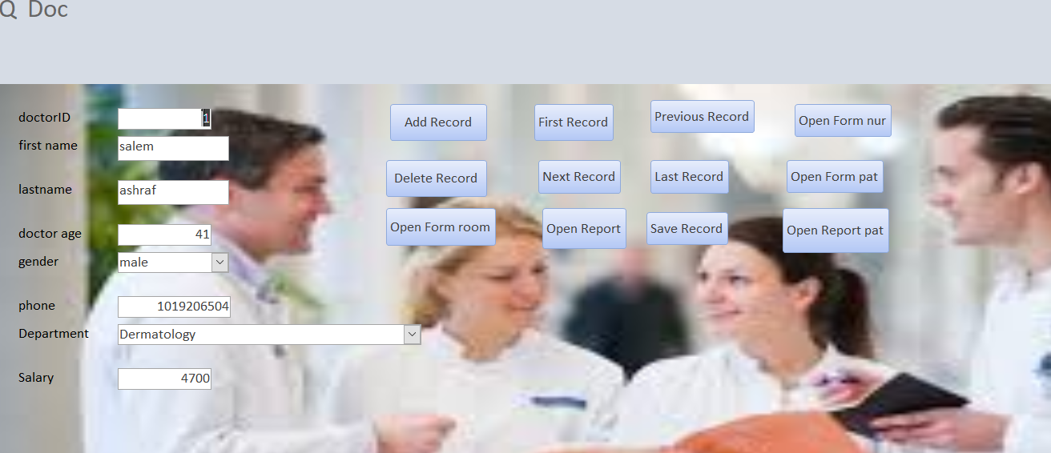

Slide 21
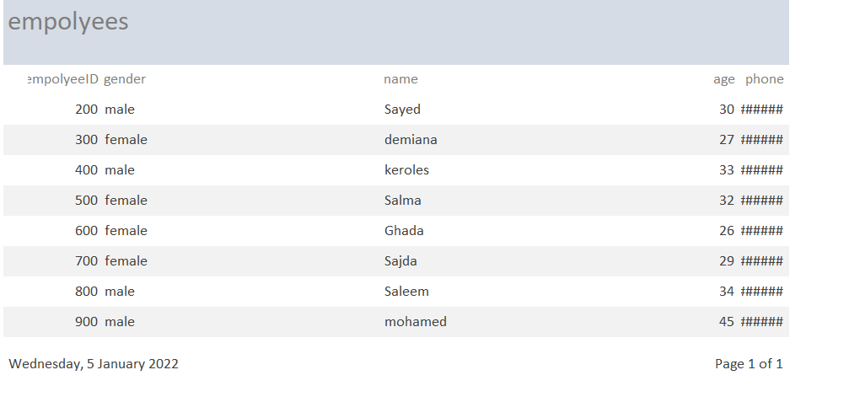

Slide 22
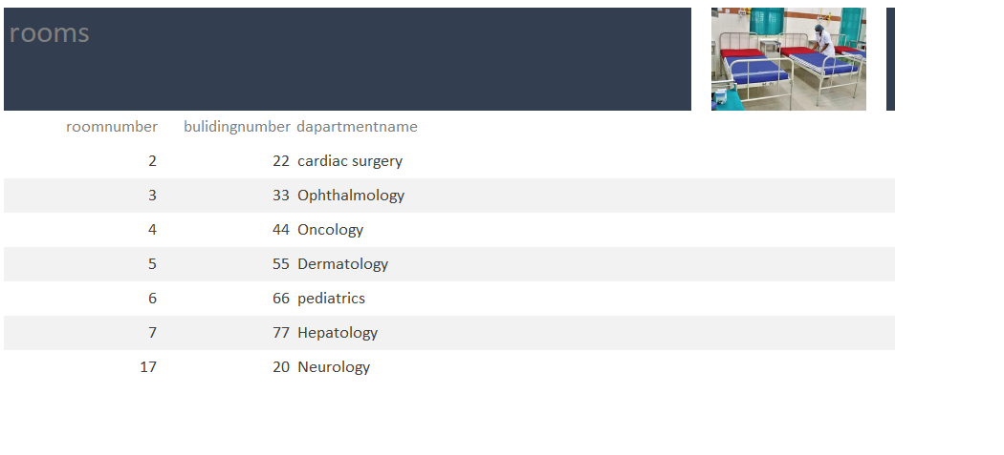
REPORT

Slide 23
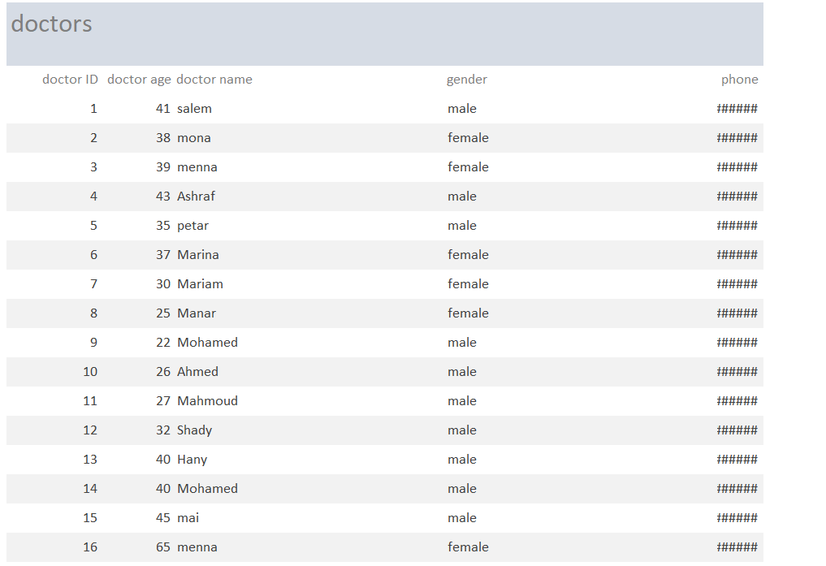

Slide 24
Link github
https://github.com/AbduSenousi/proj.IS.hospital.56.git

